Slide 1

Welcome to our presentation
on
Brain-Computer Interface (BCI)
Presented by:
Md. Mostafijur Rahman
Al Mahmud Siam
SID: 1902073
SID: 1902062
CSE 408
Technical Writing and Presentation Skill Development Sessional
Date: 03/03/2024
Department of Computer Science & Engineering
Hajee Mohammad Danesh Science & Technology University, Dinajpur-5200
Notes:
Assalamualykum. Good morning everyone. Thanks for giving me opportunity to discuss on our topic. My name is Mostafijur Rahman. My student Id is 192073.

Slide 2
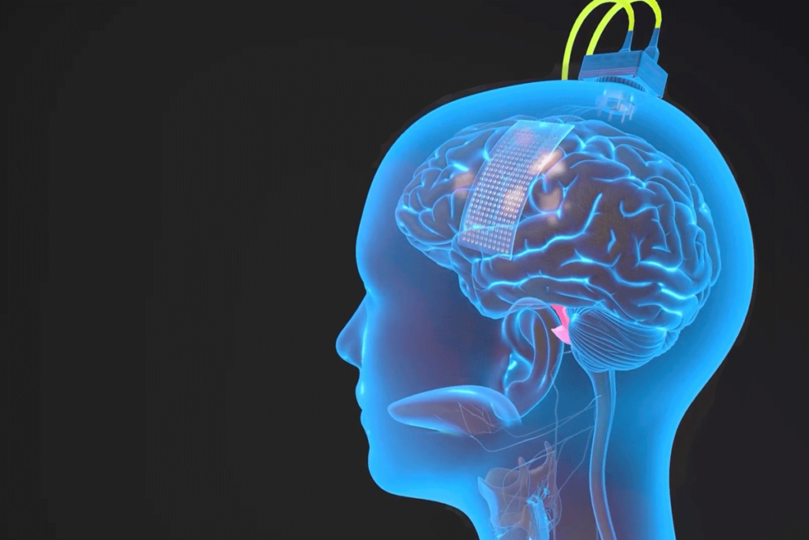
Brain Computer Interface (BCI)
Notes:
Our Topic Name is Brain Computer interface acrony as BCI. I use this acronym in the next slides. Now I explore something on this topic.

Slide 3
Outline
1
Introduction
2
History
3
Working Principles of BCI
4
Types of BCI
5
Examples of BCI
6
Applications
7
Advantages and disadvantages
8
Future Work and Research Scope
9
Conclusion
10
References
Notes:
This is the outline of our presentation.

Slide 4
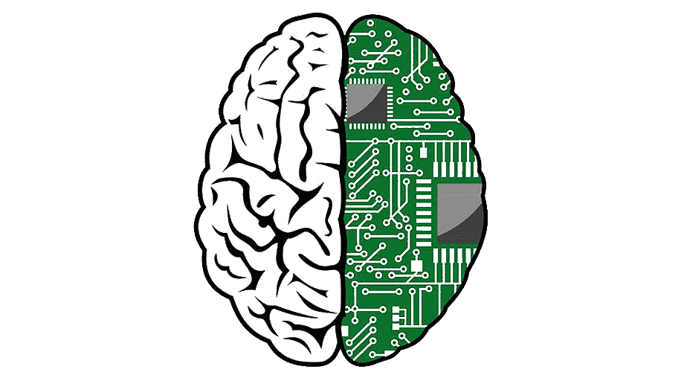
Introduction
A Brain-Computer Interface (BCI) is a technology that allows a human to control a computer, peripheral, or other electronic device with thought [1].
It does so by using electrodes to detect electric signals in the brain which are sent to a computer.
The computer then translates these electric signals into data which is used to control a computer or a device linked to a computer.
Notes:
First of all we have to know What is BCI?
BCI is a modern advancing technology that enables direct communication between the human brain and the external devices.
It allows human to control a computer, peripheral, or other electronic devices.
In BCI we use electrodes that reads human brain electric signals and sends these signals to the computer.
Then the computer converts these signals into commands that controls different devices.

Slide 5
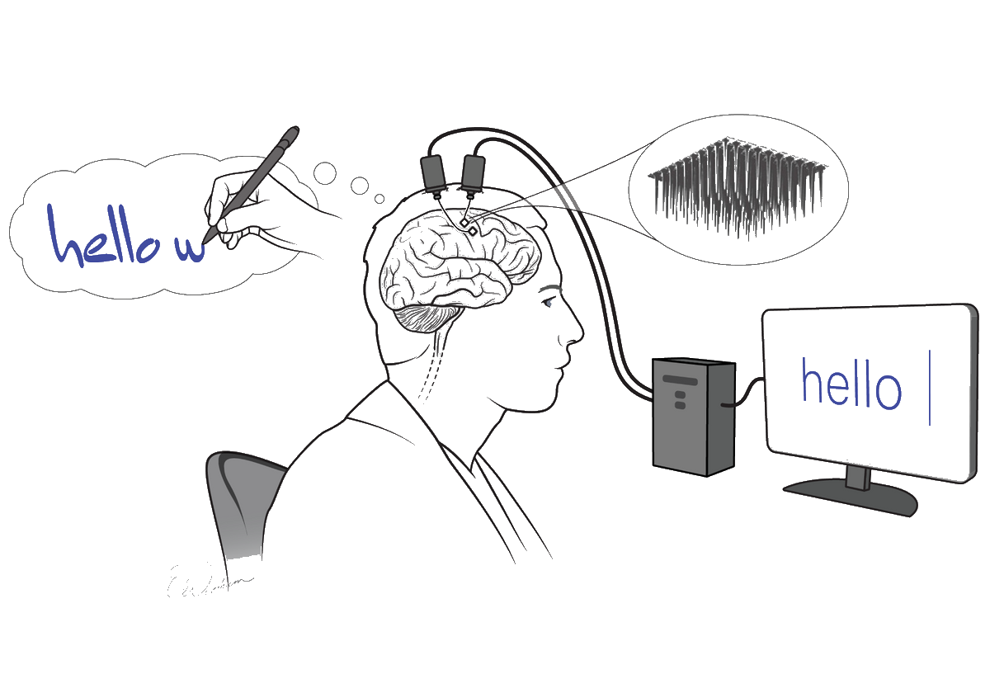
Understanding of BCI at a Glance
Notes:
This is the basic representation of BCI. We can understand BCI easily through this image.
Here Small chip with electrodes are inserted on human brain.
We can see a man is thinking to show ‘hello’ word on the computer screen.
Electrodes reads the signal of human brain.
The signals are converted into data that are shown in computer screen.

Slide 6

Major Historical Events
1924 ,Hans Berger, a German neurologist was the first to record human brain activity by means of EEG.
1970, Research on BCIs began at the University of California Los Angeles (UCLA).
1978, A prototype was implanted into a man blinded in adulthood.
Following years of animal experimentation, the first neuroprosthetic devices implanted in humans appeared in the mid-1990s.
2005. Matthew Nagle was one of the first persons to use a BCI to restore functionality lost due to paralysis. Thoughts to text translation
2013 Duke University researchers successfully connected the brains of two rats with electronic interfaces that allowed them to directly share information, in the first-ever direct brain-to-brain interface. [2]
Notes:
1924s: Hans Berger's shows the Electroencephalogram (EEG) mechanism
1970s: First Brain-Controlled Devices invented
1978s: A BCI prototype is implemented in blided man
2005s: Thought-to-Text Translation are explored
2013s: Brain-Computer Interface for Locked-In Syndrome are shown
2016: Brain-Computer Music Interface are demonstrated
2017: Elon Musk's Neuralink Announcement
2020s: Advancements in Neural Implants and AI

Slide 7


Working Principles of
BCI
Notes:
Now moving on the working principles of BCI

Slide 8

How the brain turns thoughts into action ?
The brain is full of neurons; these neurons are connected to each other by axons and dendrites.
Our neurons - as we think about anything or do anything - are at work.
Our neurons connect with each other to form a super highway for nerve impulses to travel from neuron to neuron to produce thought, hearing, speech, or movement.
If we have an itch and we want to scratch it; then we received a stimulus (an itch) and reacted in response to the stimulus by scratching.
The electrical signals that generated the thought and action travel at a rate of about 250 feet per second or faster, in some cases. [3]
Notes:
Before discuss about the working principles of BCI we have to know how………………
We know that the basic building block of brain is neuron. Neurons are connected through axons and dendrites.
All of our every activity are controlled by neurons.
They connected each other and form a super highway for nerve impulses to travel neuron to neuron to produce thoughts.
When neuron receives a stimulus, such as from another neuron or from sensory input it creates electric field called signals.
Electric signals travels at the rate of 250 feet per second faster.

Slide 9
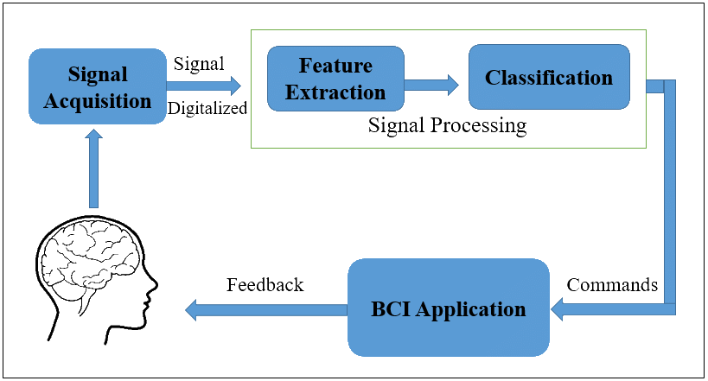
Basic block diagram of a BCI system incorporating signal detection, processing and deployment
Notes:
This diagram illustrate different steps of BCI mechanisms.
First of all Signal acquisition process detects signals from human brain through some techniques.
Then The signal is digitalized for computer interpretation.
The next step is Signal processing which ensures the reliable signals and extracts useful information from the raw brain signals.
Under the signal processing we have some techniques- named as
Feature extraction(for extracting relevant features)
Filtering To remove unwanted noise
Amplifier for increasing the strength or magnitude of the weak electrical signals
Classification(categorizing and labeling signals).
Processed signals are transformed into actionable commands using decoding algorithm.
We can use Machine learning algorithms to learn human brain pattern from signals.
Feedback is send to the interface of end users.
User interface (visual, auditory, haptic feedback)
Control Interface( some effector device such as robotic arms, wheel chair, computer cursors)

Slide 10
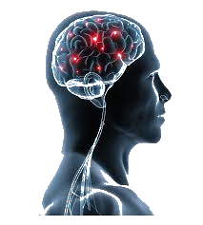
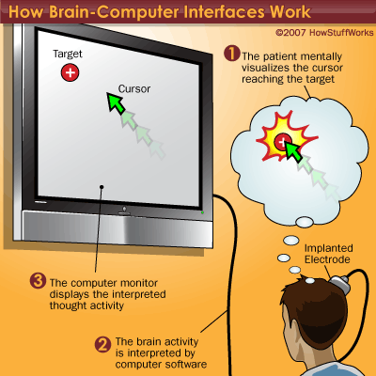
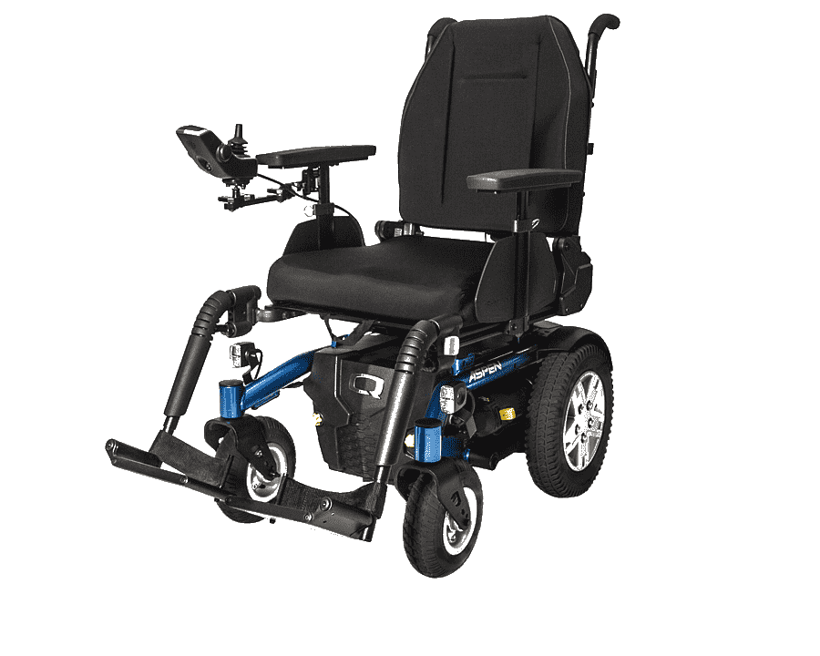
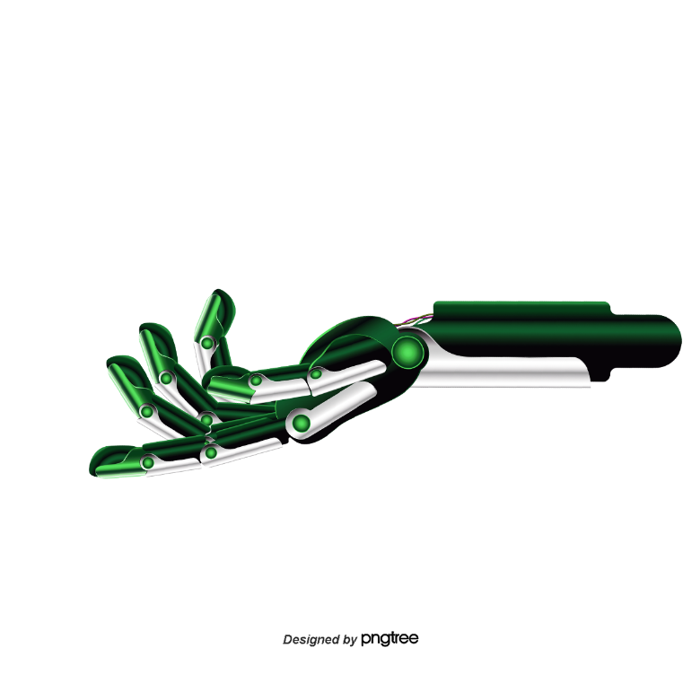
Signal Acquisition
Signal Processing
Effector Devices
EEG
ECoG
LEP
SU
Autoregressive
Wavelets
Fourier Transform
Laplacian Filter
Common Spatial Filter
Others
Robotic Arms
Wheelchairs
Cursors
Others
Notes:
EEG- Electroencephelography
ECoG-ElectroCorticography
LEP – Laser Envoked Potentials
SU – Signals Unit Activity
For BCI application we use Effector Devicse:-
Output device that controlled by BCI based on user brain activity.
These device receive commands from BCI and translate them into actions.

Slide 11
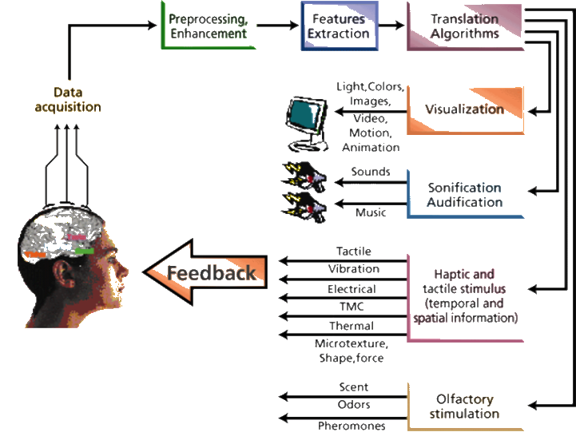
BCI Model Feedback’s

Slide 12
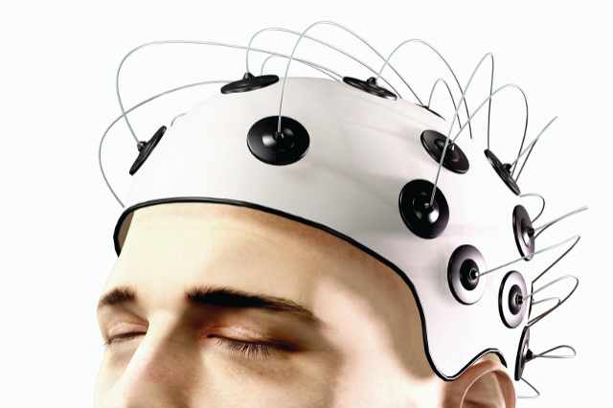
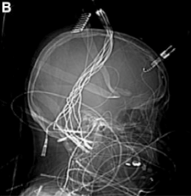
Interface
The easiest and least invasive method is a set of electrodes -- a device known as an electroencephalograph (EEG) -- attached to the scalp.
The electrodes can read brain signals.
To get a higher-resolution signal, scientists can implant electrodes directly into the gray matter of the brain itself, or on the surface of the brain, beneath the skull.
Notes:
To implement BCI the most basic methods is invasive method which acts as an interface of BCI
EEG is a device that is attached to the scalp.
Electrodes read signals of human brain
To get higher resolution signals, electrode are implanted in gray matter of the brain or on the surface of the brain

Slide 13
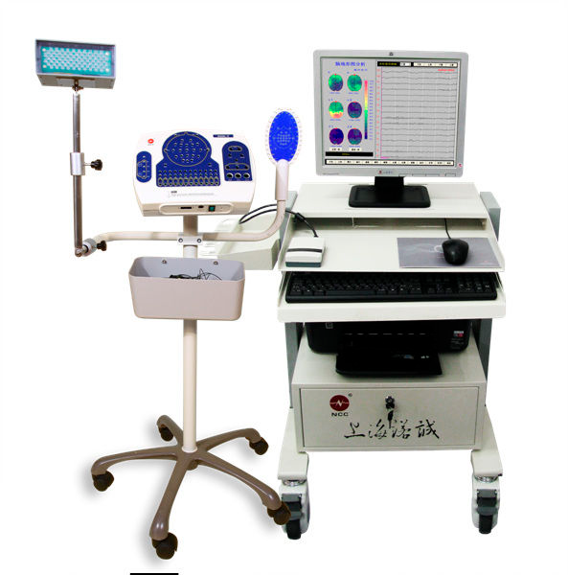
Basic Mechanism of Electrodes
Wires from each electrode transmit their measurements to a computer.
The electrodes measure minute differences in the voltage between neurons.
The signal is then amplified and filtered using some mechanism.
The computer produces a graph showing the readings from each electrode [4].
Digital EEG
Notes:
Electrode Measurements transmit to computer
Here Electrodes measures minute difference in the voltage b/w neurons
Signals are Amplified and filtered using some mechanism
Computer produces graph to show readings of electrodes

Slide 14
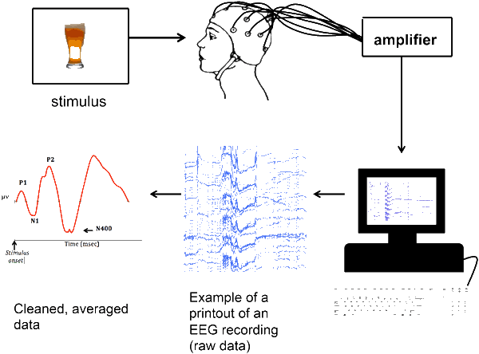
Notes:
The figure shows how stimulus are converted into signals and read by electrodes and then amplified by amplifiers
Readings of each electrodes are shown in computer.
The signals are cleaned and averaged for useful information

Slide 15
BCI Types
Invasive
Partial Invasive
Non Invasive
EEG
Neurosurgery
ECoG
MEG
fMRI
Notes:
BCI is classified based on invasiveness. There are three types of BCI
Neurosurgery is under the Invasive type of BCI
ElectroCorticography method is under the Partial invasive and
Electroencephelography, Megnetoencephelography, functional magnetic resonace imaging are under the Non invasive method

Slide 16
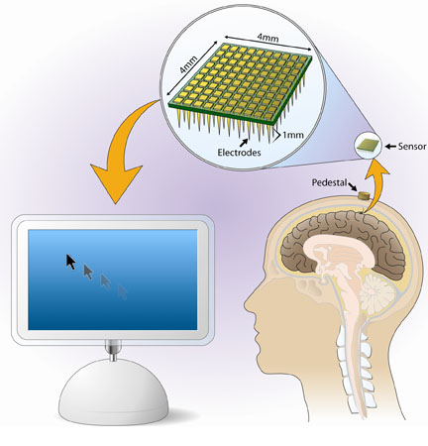
Invasive BCIs
Invasive BCIs are implanted directly into the grey matter of the brain by neurosurgery.
As they rest in the grey matter, invasive devices produce the highest quality signals of BCI devices.
But are prone to scar tissue build-up, causing the signal to become weaker or even lost as the body reacts to a foreign object in the brain.
BrainGate Neural Interface System

Slide 17
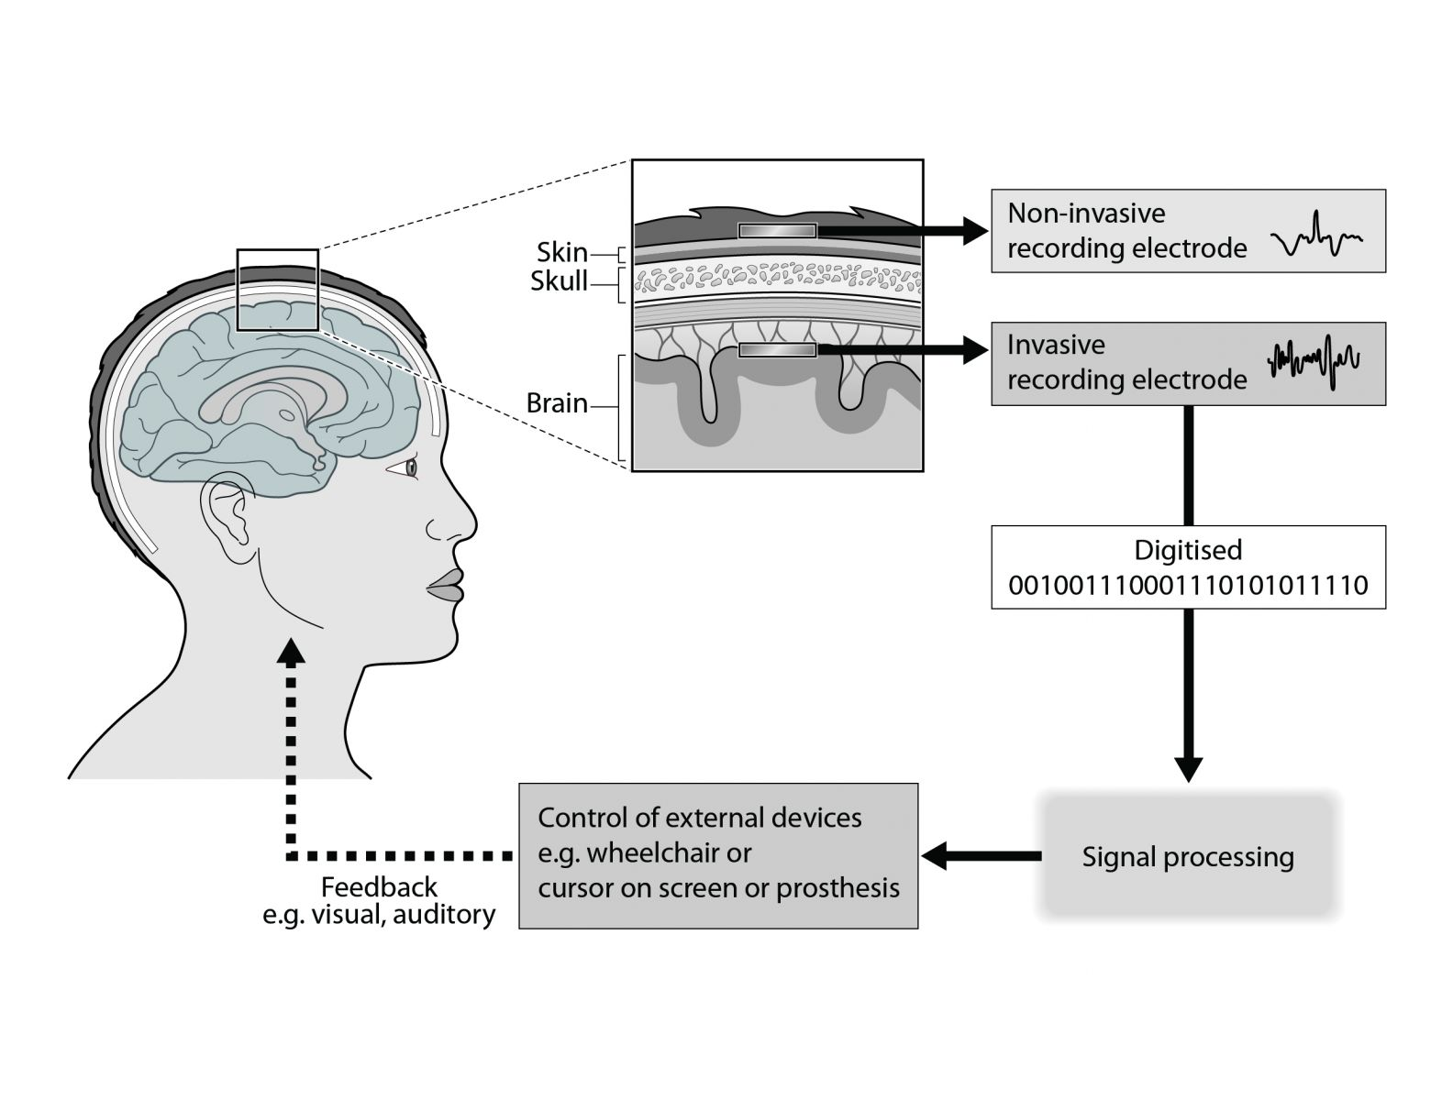

Slide 18
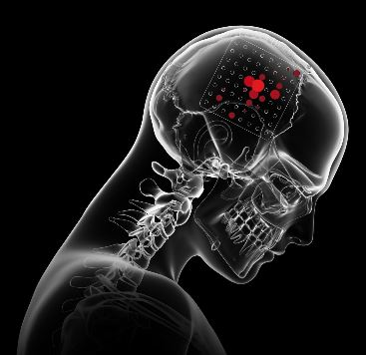
Partially Invasive
It is another brain signal reading process which is applied to the inside the skull but outside the grey matter.
Electrocorticography(ECoG) is the example of partially invasive BCI [7].
An electrocardiography (ECoG) records the activity of the brain inside the skull, but from the surface of the membranes that protect it.
An electrode Grid is being implanted by surgical incision.

Slide 19
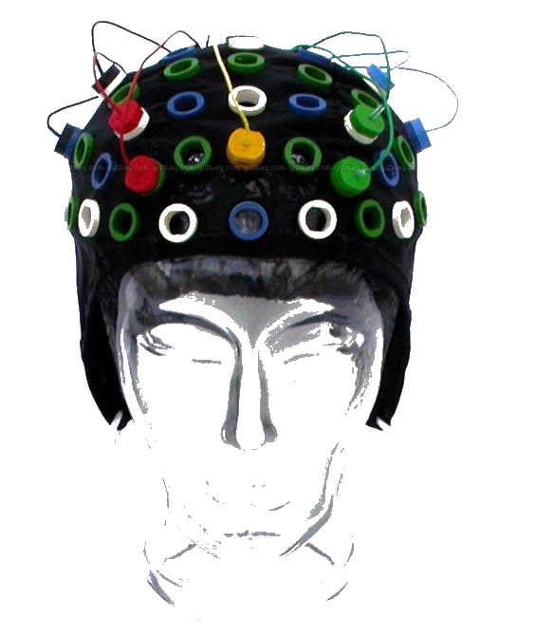
Non-Invasive
It is the most useful neuron signal imaging method which is applied to the outside of the skull, just applied on the scalp.
Techniques
Electroencephalography (EEG)
Magnetoencephalography (MEG)
functional Magnetic Resonance Imaging (fMRI)

Slide 20
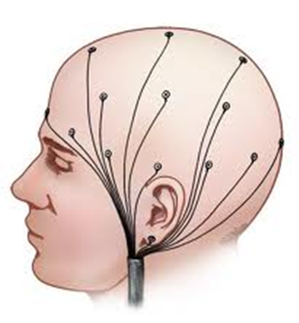
Electroencephalography EEG
In conventional scalp EEG, the recording is obtained by placing electrodes on the scalp with a conductive gel or paste, usually after preparing the scalp area by light abrasion to reduce impedance due to dead skin cells.
Many systems typically use electrodes, each of which is attached to an individual wire. [6]

Slide 21
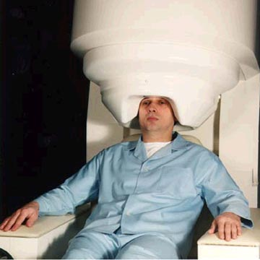
Magnetoencephalography (MEG)
MEG detects the tiny magnetic fields created as individual neurons "fire" within the brain.
It gives an indication of where electricity is flowing normally or where there are broken connections.
It can pinpoint the active region with a millimeter, and can follow the movement of brain activity as it travels from region to region within the brain.

Slide 22


MEG Save Alisa’s Life
Alisa has seizure inducing tumor close to her speech center , so surgery was required.
But due to the location of tumor there was a real risk of her speech function being affected.
In conjunction of MRI ,MEG was used to find how the tumor was causing seizures, and also to confirm the position of her speech area.
1cm margin for the safe removal of the tumor was found.

Slide 23
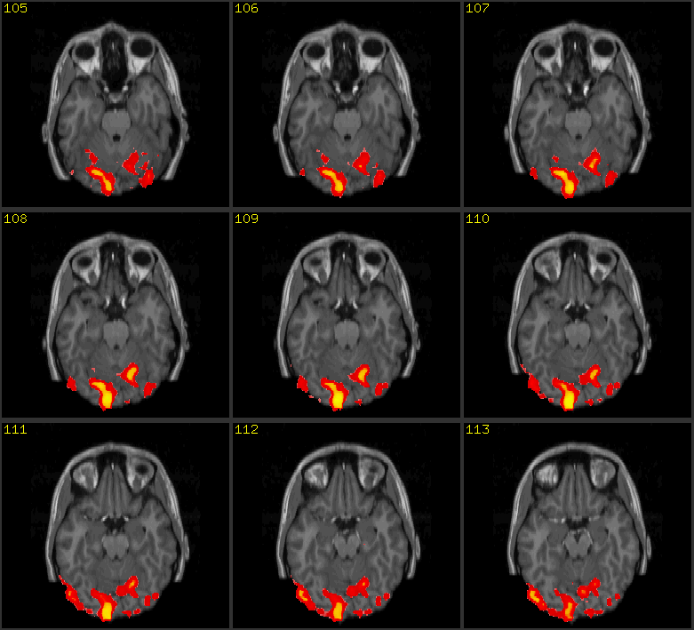
Functional Magnetic Resonance Imaging (fMRI)
It is an imaging scan that shows activity in specific areas of the brain.
Active area of brain(red color in fig.) are need more oxygen.
In fMRI lots of images of the brain are taken very quickly.
The images then processed on a computer this creates a map showing how brain activity changes when the brain doing different thing.

Slide 24
Applications
Provide disabled people with communication, environment control, and movement restoration.
Provide enhanced control of devices such as wheelchairs, vehicles, or assistance robots for people with disabilities.
Provide additional channel of control in computer games.
Monitor attention in long-distance drivers or aircraft pilots, send out alert and warning for aircraft pilots.
Control robots that function in dangerous or inhospitable situations (e.g., underwater or in extreme heat or cold).
Develop passive devices for monitoring function, such as monitoring long-term drug effects, evaluating psychological state, etc.

Slide 25
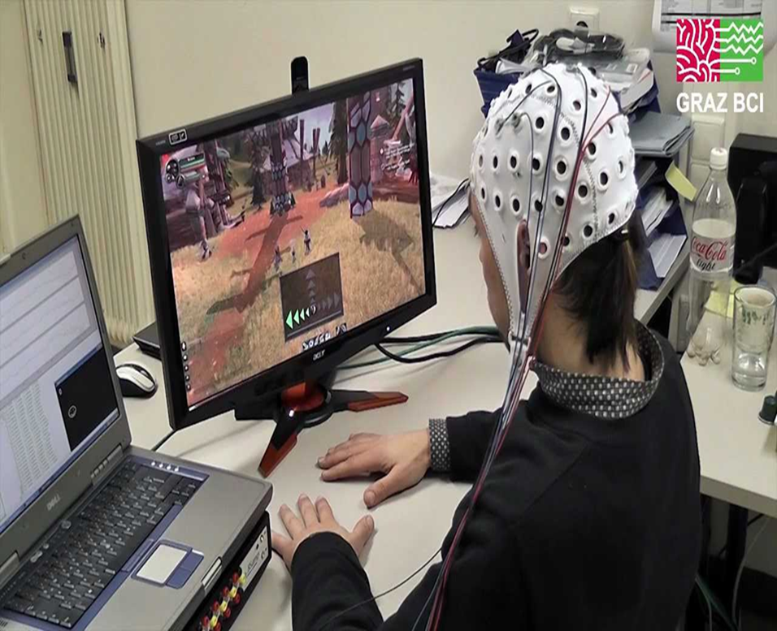
BCI Gaming
The use of brain–computer interfaces (BCIs) based on electroencephalography (EEG) in video games has been widely investigated.
The gaming part increases user engagement and makes it easier to acquire the new skill of controlling the BCI device.
BCI enables direct control of brain activity over external devices such as robots.

Slide 26
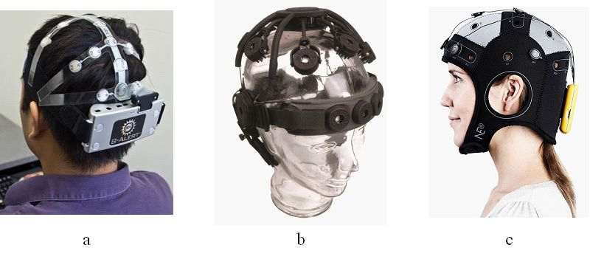

Wireless BCI systems
a b c

Slide 27
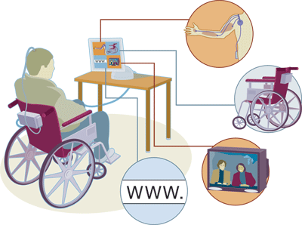
Advantages of BCI
Eventually, this technology could:
Allow paralyzed people to control prosthetic limbs with their mind.
Transmit visual images to the mind of a blind person, allowing them to see.
Transmit auditory data to the mind of a deaf person, allowing them to hear.
Allow gamers to control video games with their minds.
Allow a mute person to have their thoughts displayed and spoken by a computer.

Slide 28
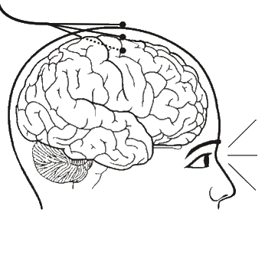
Disadvantages of BCI
Research is still in beginning stages.
The current technology is crude.
Ethical issues may prevent its development.
Electrodes outside of the skull can detect very few electric signals from the brain.
Electrodes placed inside the skull create scar tissue in the brain.

Slide 29
Future Research Scopes
Can be used as a Neurofeedback Training tool to improve cognitive performance.
Brain signals collected by noninvasive electrodes from those signals, the unique patterns can be used like a password or biometric identification.
Improving in Medical and Rehabilitation Technologies
Enhanced Human-Computer Interaction and brain-internet interfaces.
More work on Miniaturization and Wearable Devices and Long-Term Brain Health Monitoring
Research in Neuroscience, Ethical and Privacy Considerations.

Slide 30
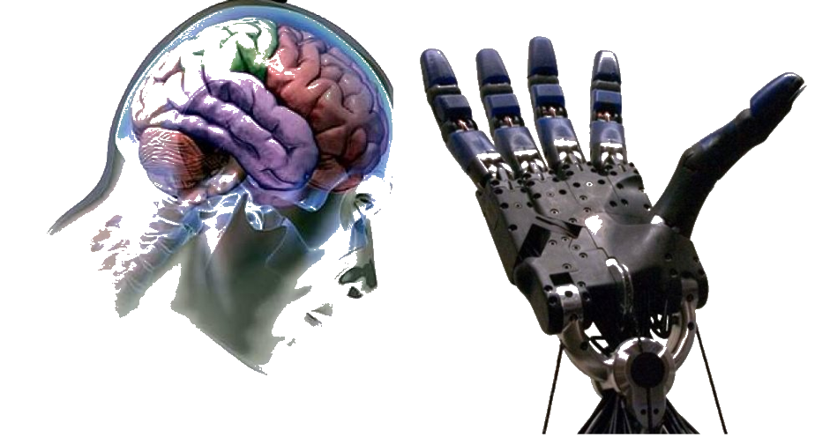
Conclusion
As BCI technology further advances, brain tissue may one day give way to implanted silicon chips thereby creating a completely computerized simulation of the human brain that can be augmented at will.
Futurists predict that from there, superhuman artificial intelligence won't be far behind.

Slide 31
References
[1] Jerry J. Shih, Dean J. Krusienski et al. Mayo Clinic Proceedings, 87, 3, 2012
[2] "Timeline of Major Historical Events in Brain-Computer Interfaces (BCIs)." OpenAI ChatGPT, 2024.
[3] Javaid, Adeel. "Brain-computer interface." Available at SSRN 2386900 (2013).
[4] Vallabhaneni, A., Wang, T. and He, B., 2005. Brain—computer interface. In Neural engineering (pp. 85-121). Boston, MA: springer Us.
[5] Leuthardt, E. C., Schalk, G., Wolpaw, J. R., Ojemann, J. G., & Moran, D. W. (2004). A brain–computer interface using electrocorticographic signals in humans. Journal of neural engineering, 1(2), 63.
[6] Vasiljevic, G. A. M., & De Miranda, L. C. (2020). Brain–computer interface games based on consumer-grade EEG Devices: A systematic literature review. International Journal of Human–Computer Interaction, 36(2), 105-142.

Slide 32


Thank You

